Slide 1


Slide 2
Hello!
I am KEVIN
You can find me at:
@kevinmaske
linkedin

Slide 3
Exploratory
Data Analysis

Slide 4

Introduction
What comes to mind when you hear EDA?

Slide 5
Introduction
What makes data “good”?

Slide 6
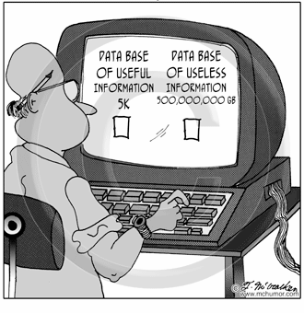
Introduction
Not all data is useful.

Slide 7

Introduction
Garbage in, garbage out

Slide 8
Introduction
P
P
A

Slide 9
Introduction
Profile
Prepare
Analyze

Slide 10
Profile
Profile
Prepare
Analyze

Slide 11

Profile
What does it mean to profile data?

Slide 12
Profile
Structure Discovery
Content
Discovery
Identify the structure of your dataset(s):
How many data points/samples
How many columns
What type of data is each column?
What are the names of each column?
What does each column represent?
Investigates the quality of individual pieces of data:
Are there any missing values?
Are there any ambiguous values?

Slide 13
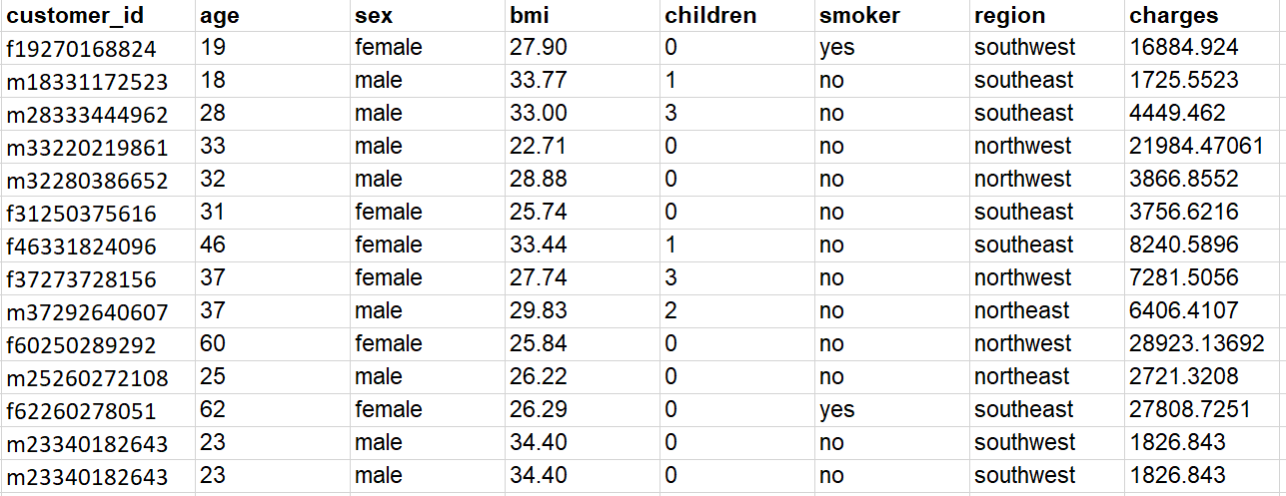
Profile
Identify the structure of your dataset(s):
How many data points/samples
How many columns
What type of data is each column?
What are the names of each column?
What does each column represent?

Slide 14
Profile
Investigates the quality of individual pieces of data:
Are there any missing values?
Are there any ambiguous values?

Slide 15
Profile
Let’s try on some sample data

Slide 16
Profile
Garbage in, garbage out

Slide 17

Profile
COMMON DATA ISSUES TO WATCH OUT FOR:
Inconsistent Column Names
Improper Data Types
Duplicates
Inconsistent Labels
Single-Value columns (and low-variability columns)
Missing Data

Slide 18
Profile
Inconsistent column names
All columns in the dataset should be properly labeled to describe its values.
Incorrect
Class Column
Bar,code
V1
Invoice - Date

Slide 19
Profile
Improper data types and format
Ensure that each column is converted into proper format and data type.
Column | Format | Type
transaction_date | “12-31-2019” | String
amount | $1,000.50 | Ambiguous

Slide 20
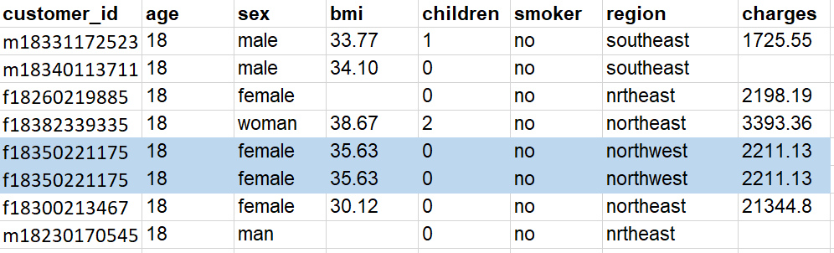
Profile
Duplicates

Slide 21
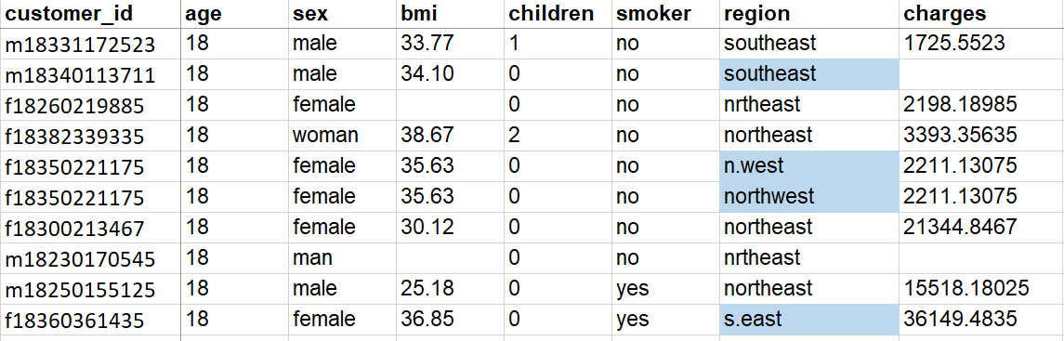
Profile
Inconsistent labels
Category labels should be consistent throughout the dataset.
There should be unique representation of each category.

Slide 22
Profile
Inconsistent labels
Category labels should be consistent throughout the dataset.
There should be unique representation of each category.
Student_Name | Computer_Type | Brand
John | PC | APPLE
Sarah | Personal Computer | lenovo
Jennifer | pc | Apple

Slide 23
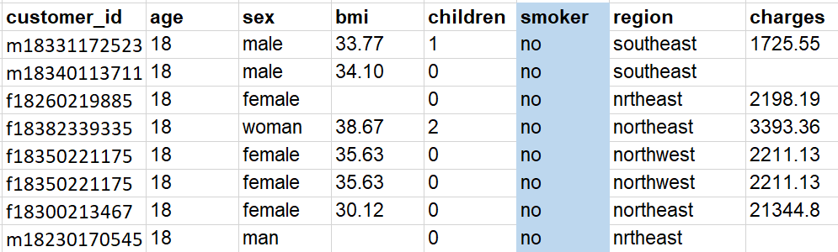
Profile
Single Value Columns

Slide 24
Profile
Low variability in values
Numerical columns that have low variance can (generally) also be discarded. They carry little information.
Transaction_ID | Location | Amount | Currency
001 | Manila | 10 | USD
002 | Manila | 10 | USD
003 | Manila | 20 | USD
004 | Manila | 10 | USD
005 | Ortigas | 10 | USD

Slide 25
Prepare
Profile
Prepare
Analyze

Slide 26
Prepare
Inconsistent column names
All columns in the dataset should be properly labeled to describe its values.
Incorrect
Class Column
Bar,code
V1
Invoice - Date
Correct
Class_column
Barcode
Transaction_date
Invoice_date
For your own convenience, make sure column names adhere to the standards of whatever coding language you’re using.

Slide 27
Prepare
Improper data types and format
Ensure that each column is converted into proper format and data type.
Column | Format | Type
transaction_date | “12-31-2019” | String
amount | $1,000.50 | Ambiguous
Correct Format | Correct Type
12-31-2019 | Date
1000.50 | Numerical

Slide 28
Prepare
Duplicates
Remove duplicates or redundant records.

Slide 29
Prepare
Inconsistent labels
Category labels should be consistent throughout the dataset.
There should be unique representation of each category.
Region
southeast
southwest
northeast
northwest

Slide 30
Prepare
Inconsistent labels
Category labels should be consistent throughout the dataset.
There should be unique representation of each category.
Student_Name | Computer_Type | Brand
John | PC | APPLE
Sarah | Personal Computer | lenovo
Jennifer | pc | Apple
Student_Name | Computer_Type | Brand
John | PC | Apple
Sarah | PC | Lenovo
Jennifer | PC | Apple
Correct

Slide 31
Prepare
Single Value Columns
Remove columns that have constant values. They don’t give any additional information at all.

Slide 32
Prepare
Low variability in values
Numerical columns that have low variance can (generally) also be discarded. They carry little information.
Transaction_ID | Location | Amount | Currency
001 | Manila | 10 | USD
002 | Manila | 10 | USD
003 | Manila | 20 | USD
004 | Manila | 10 | USD
005 | Ortigas | 10 | USD
EXCEPTION: Numerical values but are actually categories

Slide 33
Prepare
What about missing values?

Slide 34
Prepare
Mechanisms of Missingness
Missing…
Completely at Random (MCAR)
Reason for missing data is completely unrelated to the analysis being done, or the data that was collected.
At Random (MAR):
Reason for missing data is related to something that was observed or collected.
Not at Random (MNAR)
Reason for missing data is related to something that was not collected (but we would have wanted to collect)

Slide 35
Prepare
Mechanisms of Missingness
Missing…
Completely at Random (MCAR)
Cow at the survey forms.
At Random (MAR):
Executives are less likely to state their salary (but they do declare that they are executives).
Not at Random (MNAR)
People who earn more are less likely to state their salary.

Slide 36
Prepare
Mechanisms of Missingness
Missing…
Completely at Random (MCAR)
Generally safe to simply delete these rows.
At Random (MAR):
Generally unsafe to delete, worthwhile to explore imputation.
Not at Random (MNAR)
Generally unsafe to delete, worthwhile to explore imputation.

Slide 37
Analyze
Let’s try on some sample data

Slide 38
Analyze
Profile
Prepare
Analyze

Slide 39

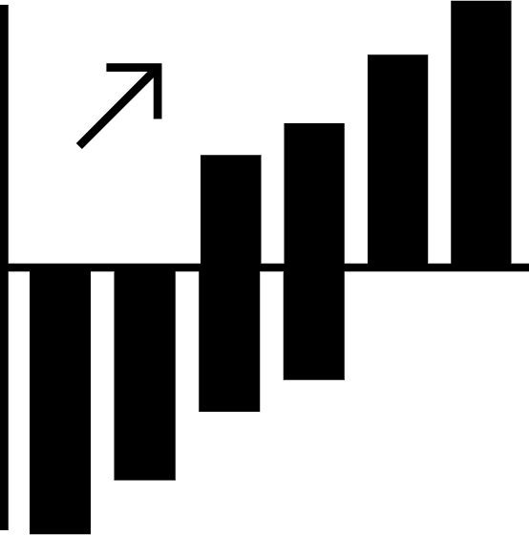
Analyze
STATISTICS
Describing, Presenting, and Analyzing Data
a
12%
Number
Table
Chart

Slide 40


Analysis
Univariate Analysis
Bivariate Analysis

Slide 41





Univariate
Summary Statistics
Average sales per transaction Average basket size
Average number of study hours of students
Average amount of loan
Average difference in house prices in NYC vs to LA.

Slide 42
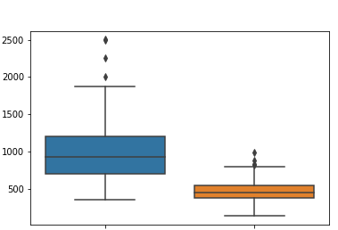
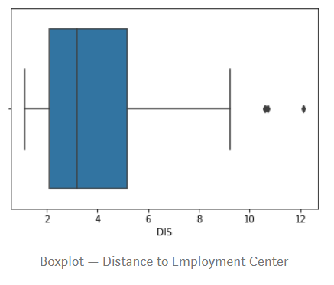
Univariate
Charts: Boxplot
Check the spread of the data. How distributed it is?
Check for outliers
Study and point out to data owners
NYC
LA
Basket size of customers (in thousands)
House prices (in thousand dollars)

Slide 43
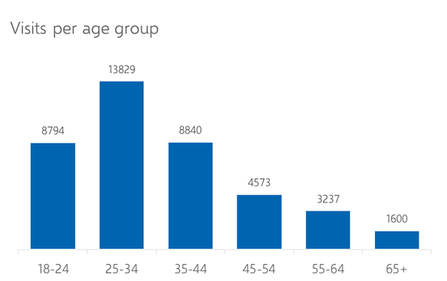
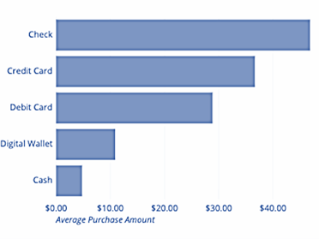
Univariate
Charts: Bar chart
Check distribution of categories
Check top/bottom categories.
Average purchase amount by payment type

Slide 44
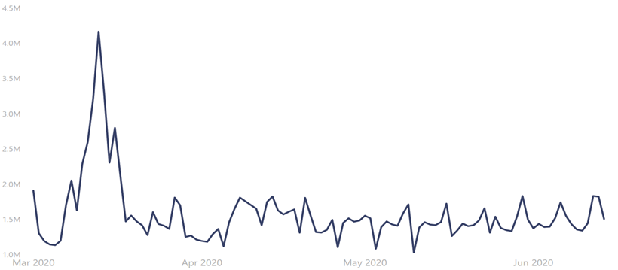
Univariate
Charts: Line chart
Inspect for trends/patterns
Number of items sold in store X

Slide 45
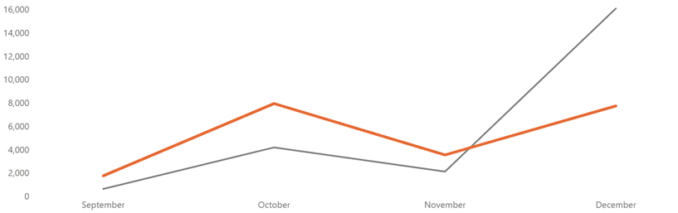
Univariate
Charts: Line chart
Compare trends
Month-on-Month number of transactions this year vs last year

Slide 46
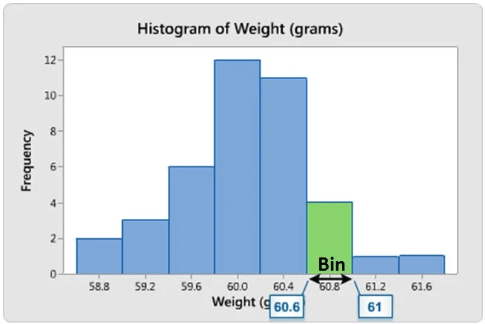
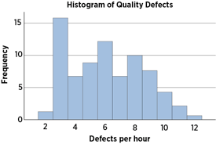
Univariate
Charts: Histogram
Check the spread of the data. How distributed it is?
Values are grouped into bins or ranges.

Slide 47
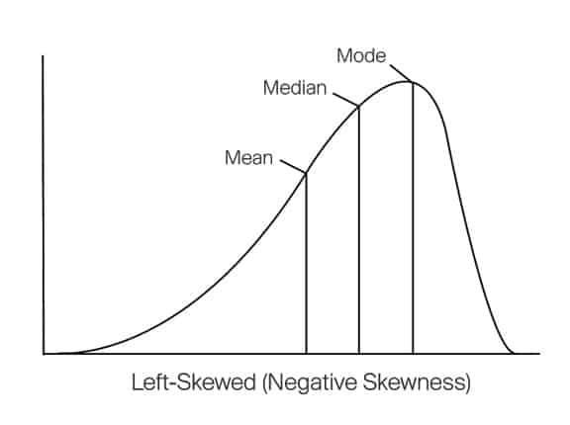
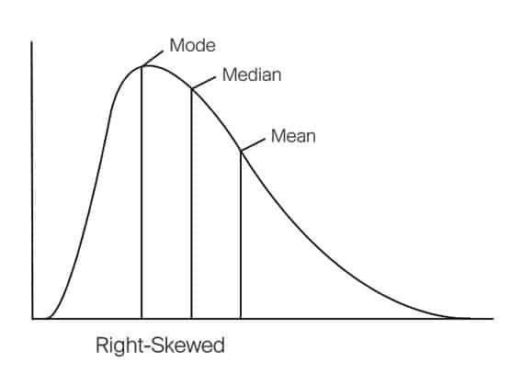
Univariate
Skewed data
What do we mean by skewed data?
Data is skewed when there are too many small values or large values.
Left skewed if there too many large values in the data.
Right skewed if there too many small values in the data.

Slide 48
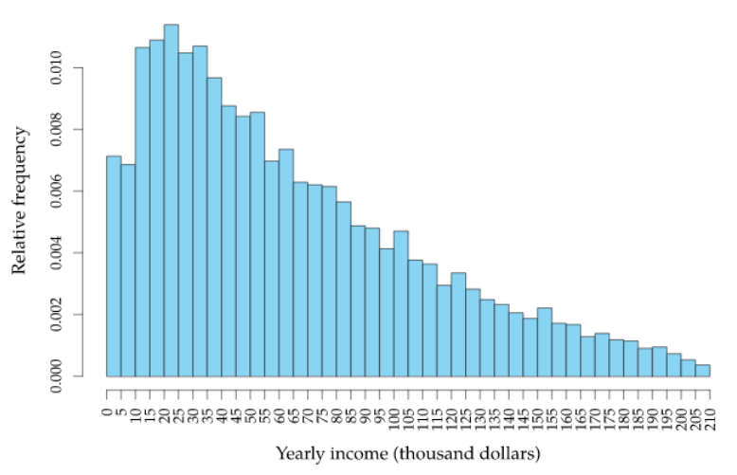
Univariate
Skewed data
Right Skewed data
The distribution tells that most of the people have incomes near to 20K dollars/year and then the number of people having higher income exponentially decreases with the increase in income.
Source: https://towardsdatascience.com/skewed-data-a-problem-to-your-statistical-model-9a6b5bb74e37#:~:text=A%20data%20is%20called%20as,as%20on%20the%20right%20side.

Slide 49
Univariate
Skewed data
Mode
Median
Mean
Source: https://towardsdatascience.com/skewed-data-a-problem-to-your-statistical-model-9a6b5bb74e37#:~:text=A%20data%20is%20called%20as,as%20on%20the%20right%20side.

Slide 50
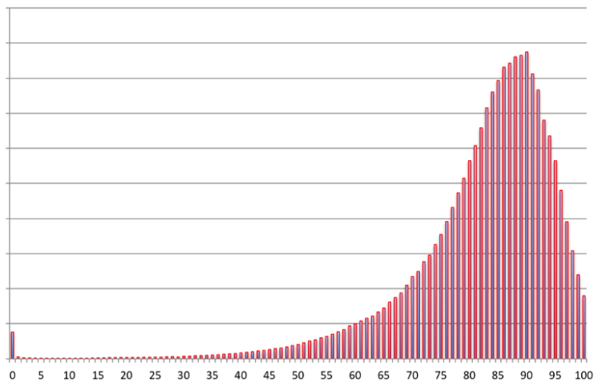
Univariate
Skewed data
Left Skewed data
The distribution tells us that most of the people die at the age of near to 90.
Frequency count
Age at death
Source: https://towardsdatascience.com/skewed-data-a-problem-to-your-statistical-model-9a6b5bb74e37#:~:text=A%20data%20is%20called%20as,as%20on%20the%20right%20side.

Slide 51
Univariate
Skewed data
Mode
Median
Mean
Frequency count
Age at death
Source: https://towardsdatascience.com/skewed-data-a-problem-to-your-statistical-model-9a6b5bb74e37#:~:text=A%20data%20is%20called%20as,as%20on%20the%20right%20side.

Slide 52
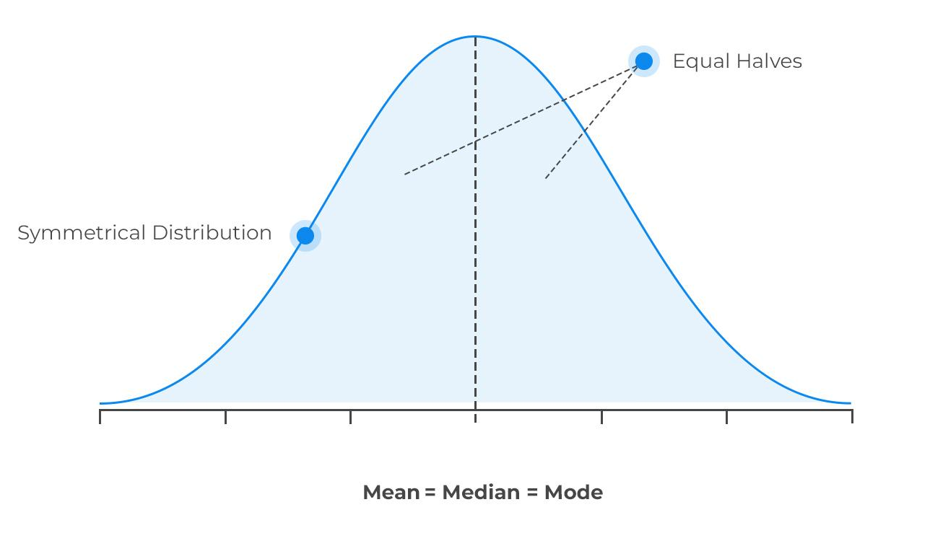
Univariate
Skewed data
Why skewness is an issue?
Most statistical models assume a normal or Gaussian distribution. If data is skewed,
Some statistical models won’t work as expected.
Observations in the tail are sometimes detected as outliers.

Slide 53
The cycle begins…
Profile
Prepare
Analyze
(again)

Slide 54
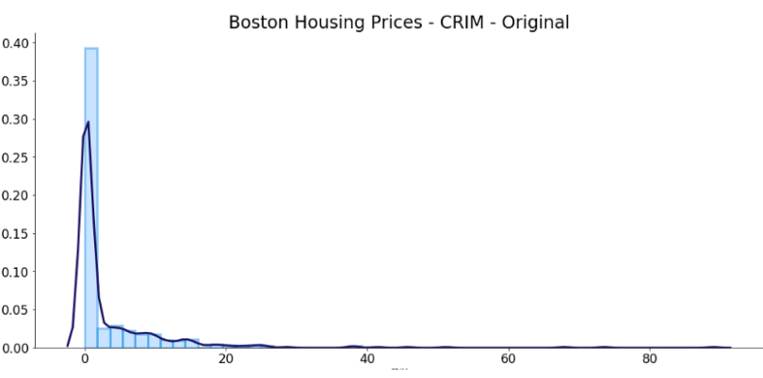
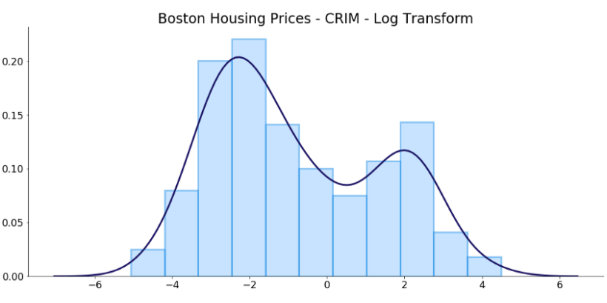
Prepare (Again)
Skewed data
How to deal with skewed data?
Log transform
Square root transform
np.log()
np.sqrt()

Slide 55
Prepare (Again)
Outliers
1 Remove
Value
Variable
2 Remove and study them separately
Studying the outlier might give a different perspective or prompts an opportunity.
3 Assign a new value
Use imputation techniques to replace the value of the outlier.

Slide 56
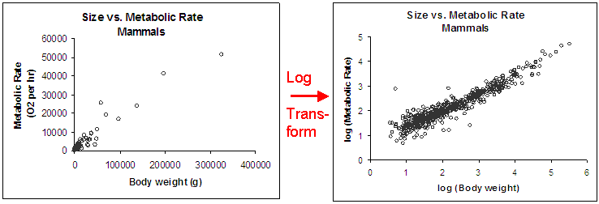
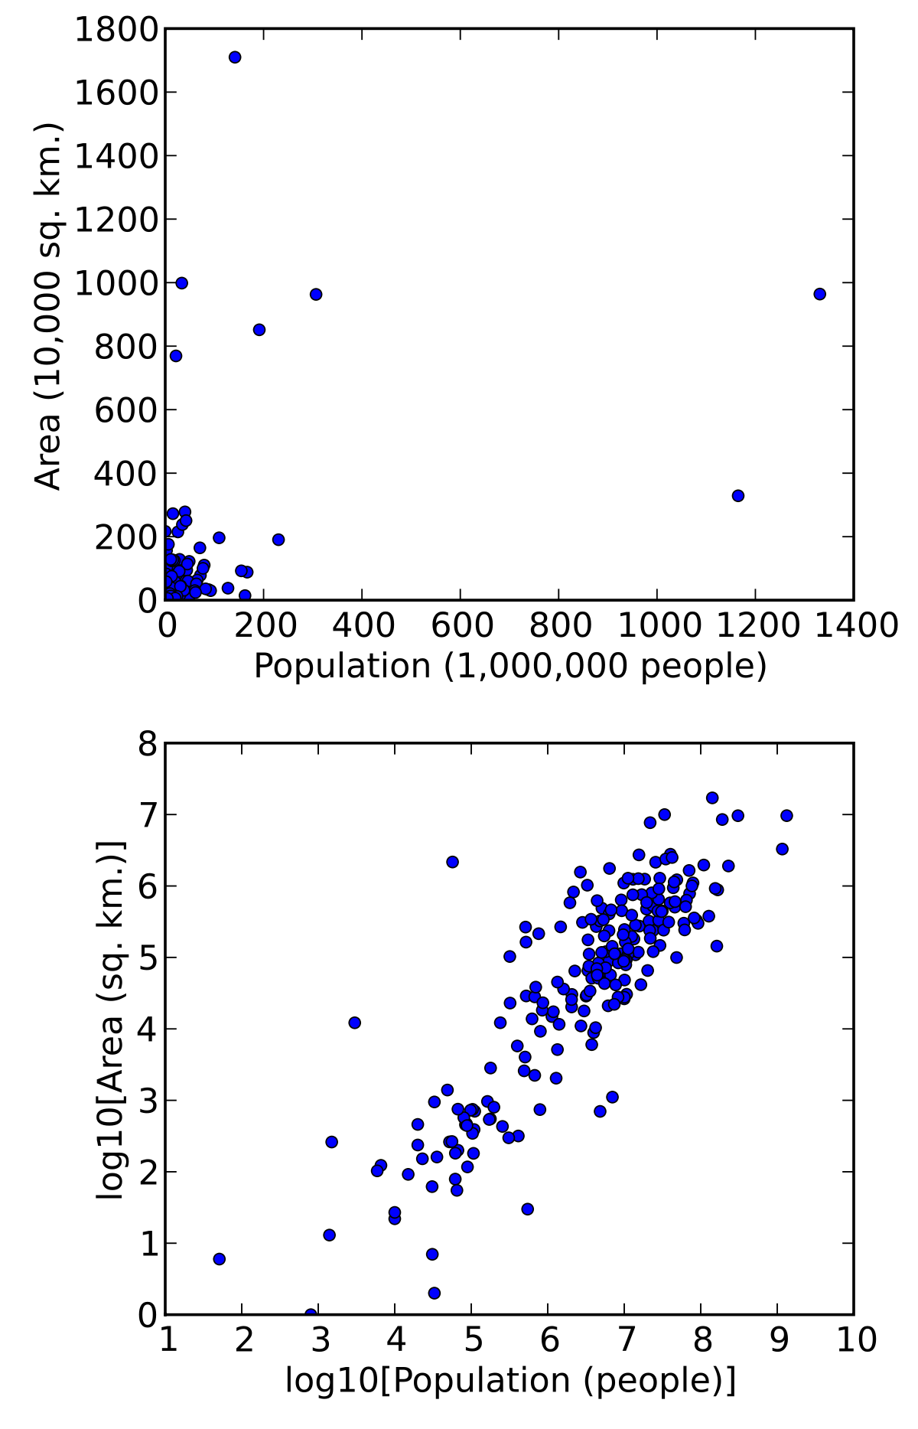
Prepare (Again)
Outliers
Transform Log transform
Value
Variable

Slide 57
Data Preparation: Feature Scaling
Prepare (Again)
Feature scaling is a method used to standardize the range of independent variables or features of data. In data processing, it is also known as data normalization and is generally performed during the data pre-processing step.
Common Methods:
Standard Scaler
MinMax Scaler
Robust Scaler

Slide 58
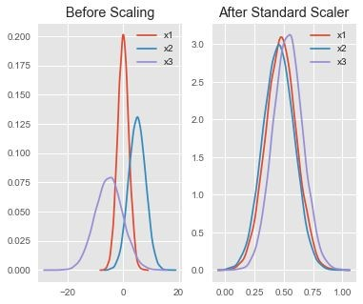
Feature Scaling: Standard Scaler
Prepare (Again)
Assumes your data is normally distributed within each feature and will scale them such that the distribution is now centred around 0, with a standard deviation of 1.
The mean and standard deviation are calculated for the feature and then the feature is scaled based on:
x_{i}–mean(x) stdev(x)
If data is not normally distributed, this is not the best scaler to use.

Slide 59
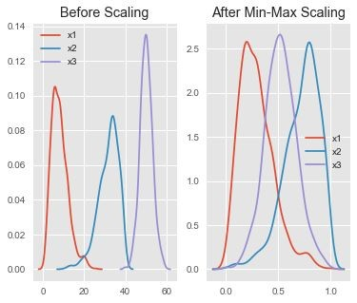
Feature Scaling: Min-Max Scaler
Prepare (Again)
One of the most well-known scaling algorithm, and follows the following formula for each feature:
x_{i}–min(x) max(x)–min(x)
It essentially shrinks the range such that the range is now between 0 and 1 (or -1 to 1 if there are negative values).
Works better than Standard Scaler for cases in which the distribution is not Gaussian or the standard deviation is very small
However, it is sensitive to outliers, so if there are outliers in the data, you consider the Robust Scaler.

Slide 60
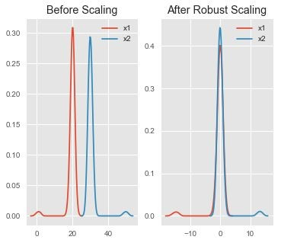
Feature Scaling: Robust Scaler
Prepare (Again)
Uses a similar method to the Min-Max scaler but it instead uses the interquartile range, rather than the min-max, so that it is robust to outliers.
Follows the formula:
x_{i}–Q₁(x) Q₃(x)–Q₁(x)
Notice that after Robust scaling, the distributions are brought into the same scale and overlap, but the outliers remain outside of bulk of the new distributions.

Slide 61
(Bivariate) Analysis
Profile
Prepare
Analyze
(again)

Slide 62
Bivariate (Analysis)
Univariate Analysis
Bivariate Analysis

Slide 63
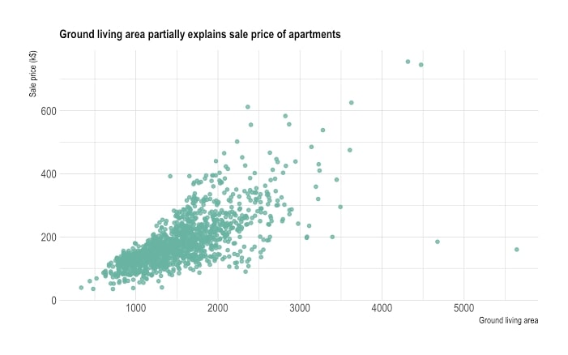
(Bivariate) Analysis
Charts: Scatterplot
Predicting house price given ground living area
Price (thousand dollars)
Ground living area

Slide 64
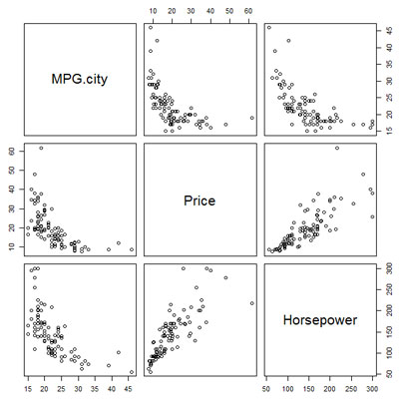
(Bivariate) Analysis
Charts: Scatterplot
Predicting car price given Horsepower and MPG (Miles per gallon)
Price and horsepower are correlated
MPG and horsepower are also correlated.
Test for Multicollinearity: Variance Inflation Factor
https://etav.github.io/python/vif_factor_python.html

